Slide 1

Airbnb listings in Beijing
Biostatistics Han Yu 2021.12.16

Slide 2
01
Background
CONTENTS
02
Data description
03
Exploratory data analysis
04
K-means and advice

Slide 3

01
PART
Background

Slide 4

Background
Airbnb Beijing
Founded in August 2008, Airbnb is a travel home rental community where users can post, search for vacation home rental information and complete online bookings. In 2015, Airbnb officially entered the Chinese market, setting off a wave of urban homestay boom in China.
01
Data visualization
02
Advice for hosts
From hosts' point of view, Airbnb's operational data in Beijing can be interactively visualized, exploring the distribution of listings in Beijing, basic housing information, price trends, host income.
If a host plans to rent out his house, based on the known information of the listing, k-means unsupervised clustering method can be used to give advice about the price of his listing.
Notes:
Airbnb entered Chinese market in 2015 and quickly succeeded. Beijing is the capital of China and one of Airbnb's most successful cities in China. Most current analysis were from the perspective of tenants. In this project, I decided to look the things from another perspective, the host's perspective and gave the advice on price of the listings.

Slide 5
02
PART
Data Description

Slide 6
Resources and FAIRness
Data Resources
How does the data came to us
The data was retrieved from the official website of Airbnb. They published dataset from different regions and countries.
You can get the dataset from here:
http://insideairbnb.com/get-the-data.html
The data behind the Inside Airbnb site is sourced from publicly available information from the Airbnb site.
Data Format
FAIRness
Data is stored in .csv format and geojson format.
This dataset follows FAIRness principle.

Slide 7
Data Description
Datasets | Description | How to use
listings.csv | Detailed Listings data for Beijing | Used to do data visualizaion and analysis
neighbourhoods.geojson | GeoJSON file of neighbourhoods of the city. | Used to draw the map of the distribution of listings in Beijing

Slide 8
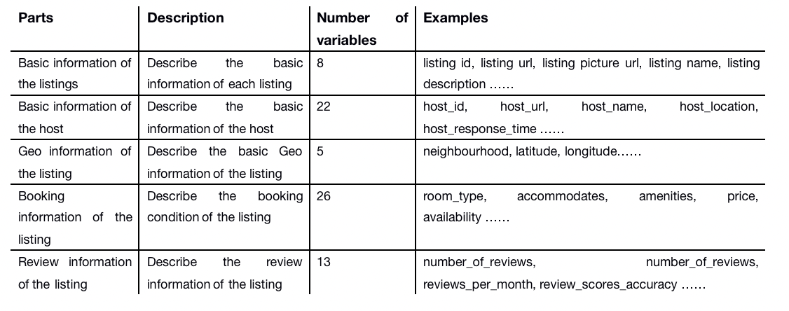
Data Description - listing.csv

Slide 9
03
PART
Exploratory Data Analysis

Slide 10
Data preprocessing
Standardization and data correction
Select variables and deal
with missing values
Change the categorical variables into standard format.
Operation: change “neighbourhood”into English
14 variables and 24998 listings
are selected to do future analysis.
Step 1
Step 2
Step 3
Final
Remove outliers of listing data
Define new variables to
be used in analysis
1. Delect the listings that are under test, delisted and not rent (24)
Operation: View the descriptions of the listings and find the key words.
2. Remove the unnormal listings based on price(4)
Operation: Delect the listings with price lower than 10 or higher than 990k.
1. host type: calculated_host_listings_count
Personal: <5; Small scale company:(5,20]; Medium scale company: (20,100]; Large scale company: >100.
2. Availability: availability_365
highly available: the listing is available for more than 60 days per year; lowly available: the rest.
3. Income
The minimum number of days that can be booked * Review per month * Available days per month * Price

Slide 11
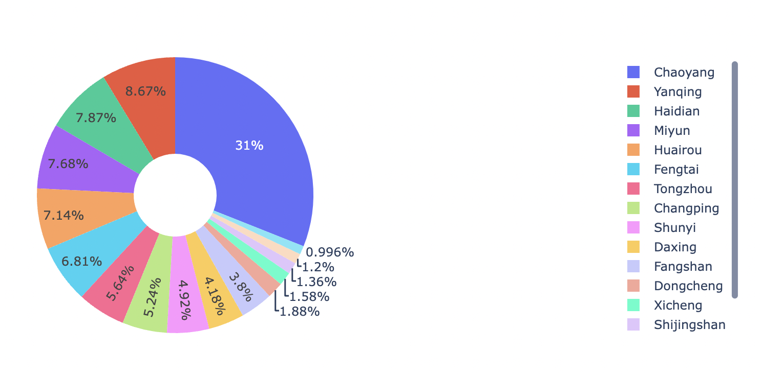
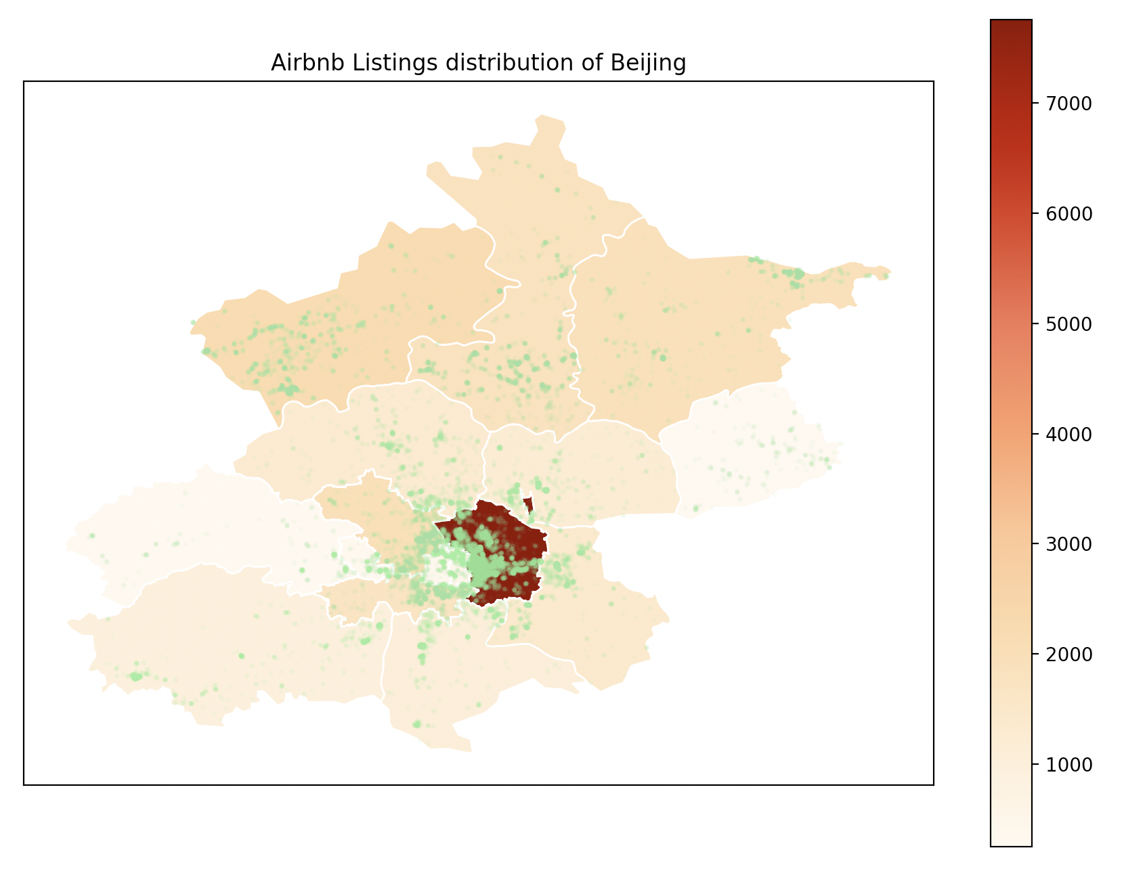
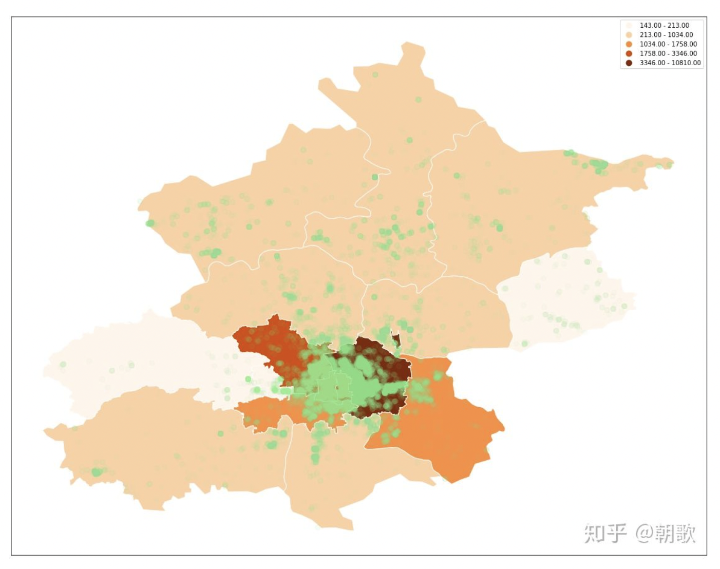

Whole city analysis - Listing distribution
Chaoyang: 7758
2019
Chaoyang: 10810
Notes:
Chaoyang district has the highest proportion of listings, more than 30%. Other districts are more evenly distributed. The distribution of listings in Beijing is related to the geographical location, and the closer to the center of the city, the more concentrated the listings.
The tourism in Beijing is highly developed, most traditional tourist attractions are concentrated in the center of the city, such as the forbidden city.
There is one more thing I found interesting is that. Compared with the listing distribution in 2019, the number of listings in Chaoyang District is 3,000 more than this year. And the center of the city accounts for more than 60% percent of the listings. However, this year, the number of listings in suburb is pretty high.
Yanqing is the venue for the Winter Olympics in China, so the tourism in Yanqing has developed a lot.

Slide 12
Whole city analysis - Summary
Room type:
The mainly room type of Airbnb in Beijing is Entire home/apt.
Host type:
More than half of the hosts just rent their own houses.
Availability:
Nearly 90% of the listings are under low available condition ( the available days per year is less than 60 days. )
Price:
The average price of the listings in suburbs is much higher, like Huairou, Yanqing, Pinggu.
Income:
The average income of the hosts in Dongcheng is the highest.

Slide 13
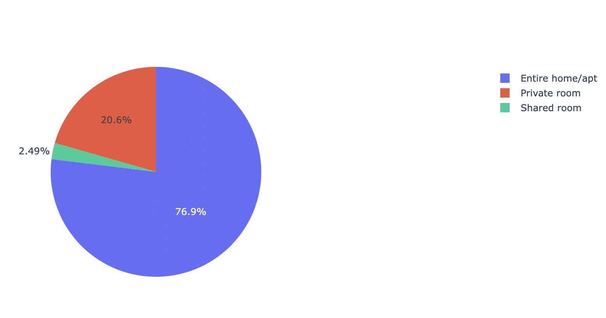
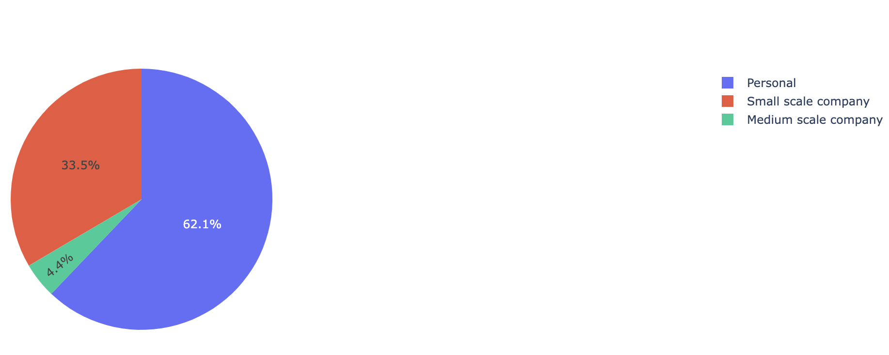
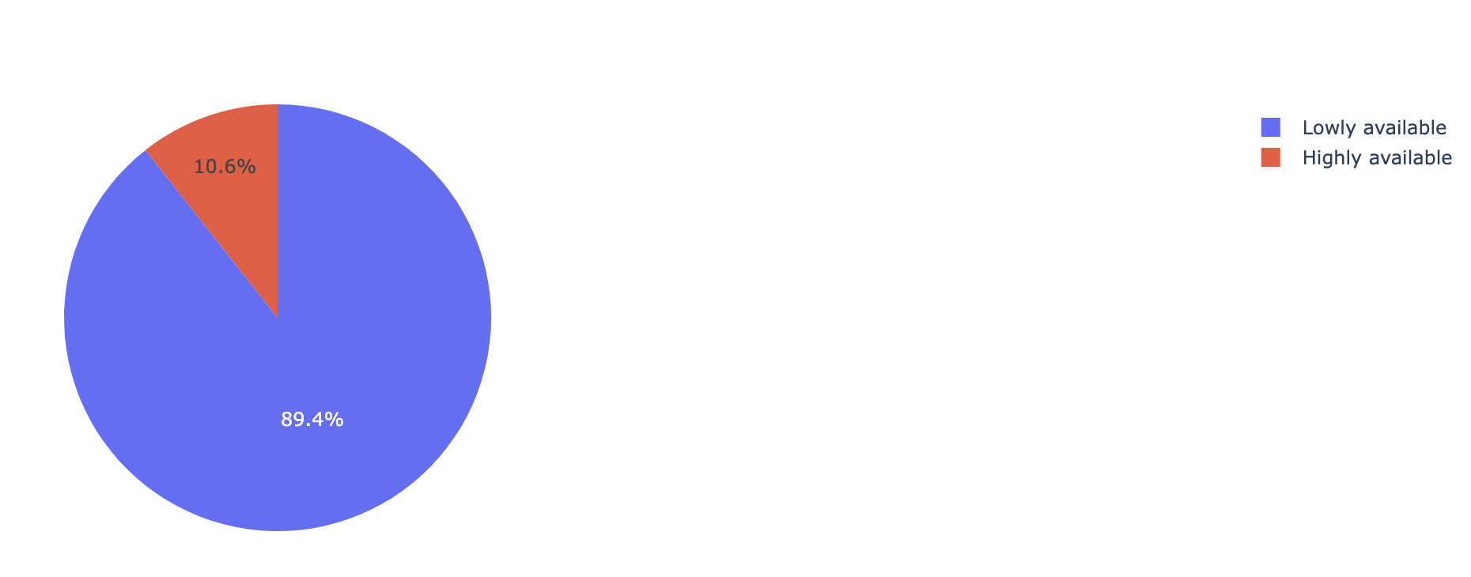
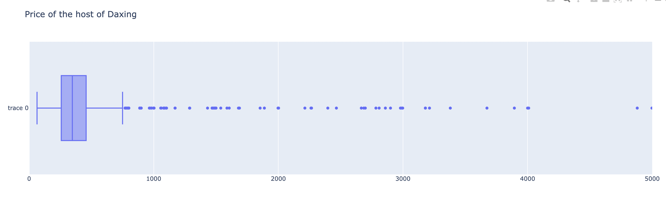
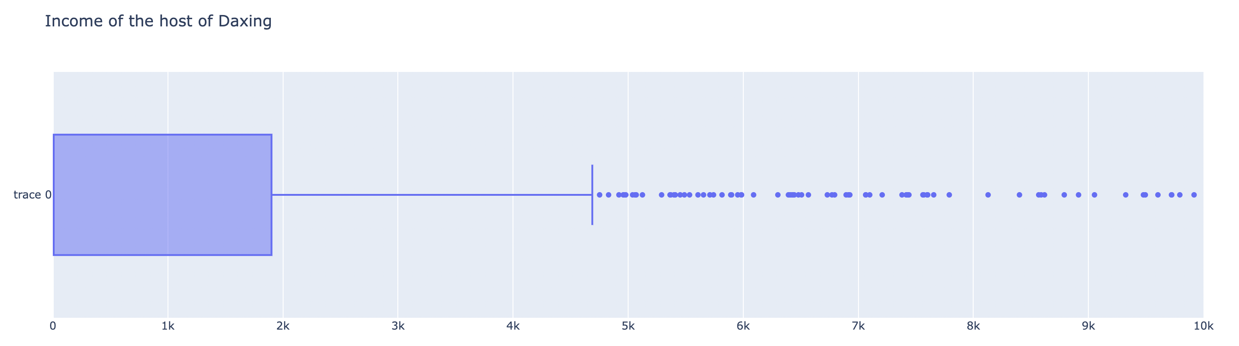
Each district analysis
Room type:
Host type:
Availability:
Price:
Income:

Slide 14
04
PART
K-means and advice

Slide 15
K-means
neighbourhood
latitude; longitude
The district this listing belongs to.
Considering whether the position of the listing close to the business district, subway, etc.
room_type
host type
['Entire home/apt', 'Private room', 'Shared room']
['Small scale company', 'Personal', 'Medium scale company', 'Large scale company']
accommodates
minimum_nights
The largest number of people that can accommodate. Indicate the size of the listing.
The minimum number of nights that can book.
availability_30
The largest number of days that your listing is available per month.

Slide 16
THANKS

